Slide 1
CH 11: Trees

Slide 2
Content
CH 11
Introduction to Trees
Spanning Trees

Slide 3
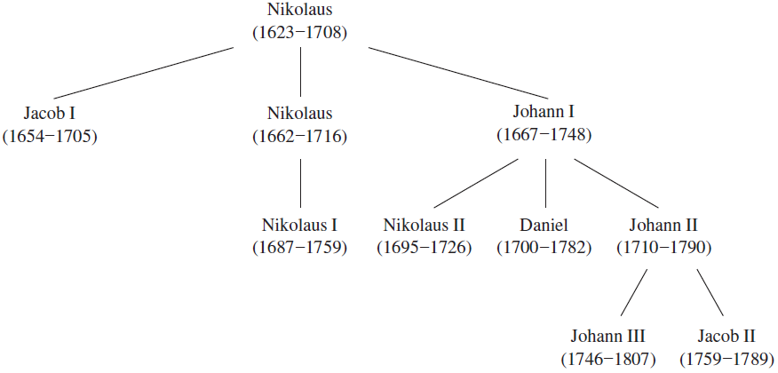
Introduction to Trees
A tree is a connected undirected graph with no simple circuits.

Slide 4
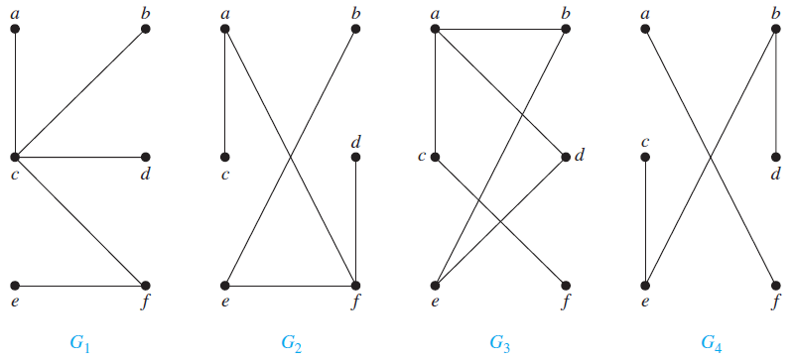
Introduction to Trees
Because a tree cannot have a simple circuit, a tree cannot contain multiple edges or loops.
G1 and G2 are trees, because both are connected graphs with no simple circuits.
G3 is not a tree because e, b, a, d, e is a simple circuit in this graph.
G4 is not a tree because it is not connected.

Slide 5
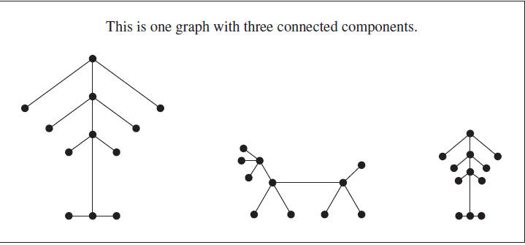
Introduction to Trees
Forests are connected components of trees.

Slide 6
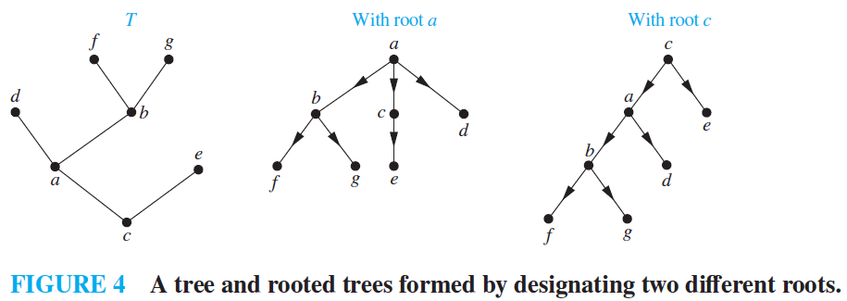
Introduction to Trees
A rooted tree is a tree in which one vertex has been designated as the root and every edge is directed away from the root.

Slide 7

Introduction to Trees
If $v$ is a vertex in $T$ other than the root, the parent of $v$ is the unique vertex $u$ such that there is a directed edge from $u$ to $v$.
$v$ is called a child of $u$
Vertices with the same parent are called siblings.
The ancestors of a vertex other than the root are the vertices in the path from the root to this vertex, excluding the vertex itself and including the root.
A vertex of a rooted tree is called a leaf if it has no children.

Slide 8
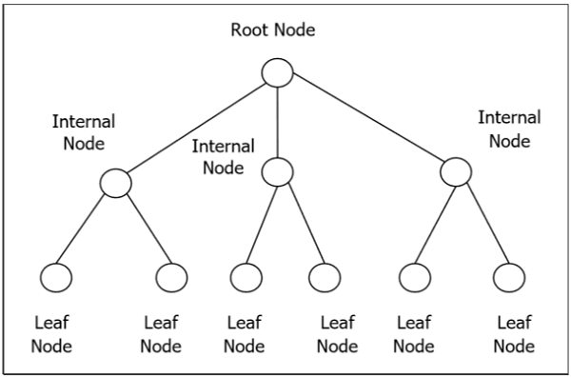
Introduction to Trees

Slide 9
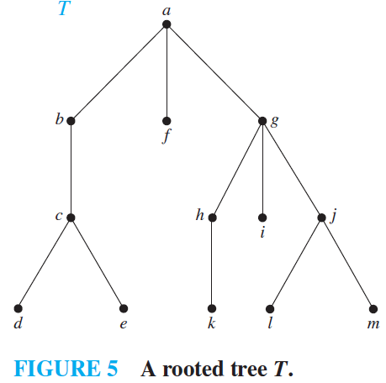

Introduction to Trees
In the rooted tree $T$ (with root a) shown in Figure 5, find the parent of c, the children of g, the siblings of h, all ancestors of e, all descendants of b, all internal vertices, and all leaves. What is the subtree rooted at g?

Slide 10
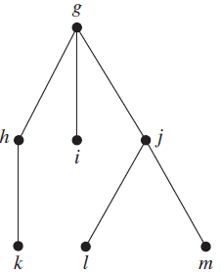

Introduction to Trees
In the rooted tree $T$ (with root a) shown in Figure 5, find the parent of c, the children of g, the siblings of h, all ancestors of e, all descendants of b, all internal vertices, and all leaves. What is the subtree rooted at g?
The parent of c is b.
The children of g are h, i, and j.
The siblings of h are i and j.
The ancestors of e are c, b, and a.
The descendants of b are c, d, and e.
The internal vertices are a, b, c, g, h, and j.
The leaves are d, e, f , i, k, l, and m.

Slide 11

Introduction to Trees
A rooted tree is called an $m−ary$ tree if every internal vertex has no more than $m$ children. The tree is called a full 𝑚−𝑎𝑟𝑦 tree if every internal vertex has exactly $m$ children.
An $m−ary$ tree with $m = 2$ is called a binary tree.

Slide 12
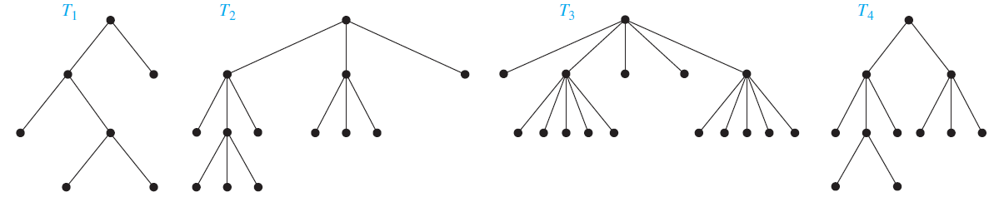
Introduction to Trees
Are the rooted trees in Figure 7 full m-ary trees for some positive integer m?

Slide 13

Introduction to Trees
Are the rooted trees in Figure 7 full m-ary trees for some positive integer m?
$T_{1}$ is a full binary tree because each of its internal vertices has two children.
$T_{2}$ is a full 3-ary tree because each of its internal vertices has three children.
$T_{3}$ each internal vertex has five children, so $T_{3}$ is a full 5-ary tree.
$T_{4}$ is not a full m-ary tree for any m because some of its internal vertices have two children and others have three children.

Slide 14
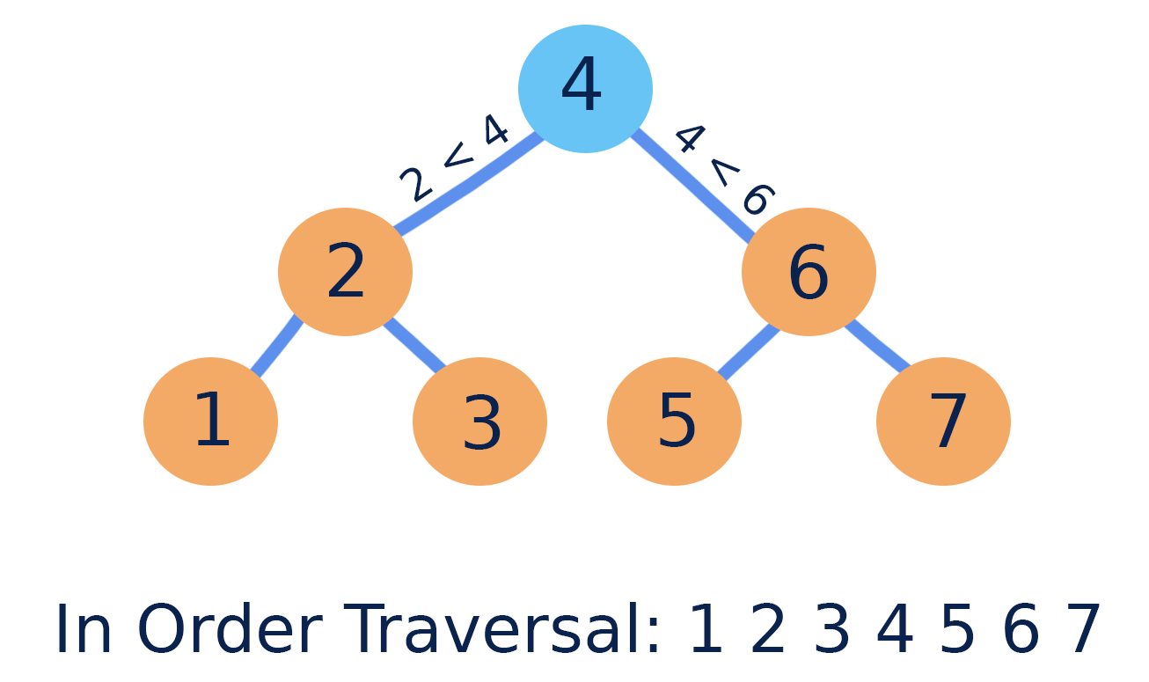
Introduction to Trees
An ordered rooted tree is a rooted tree where the children of each internal vertex are ordered from left to right.

Slide 15
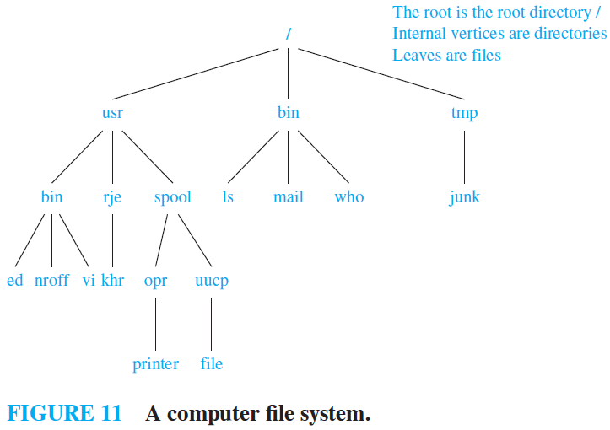
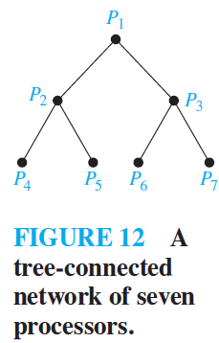
Introduction to Trees
Trees are used as models in such diverse areas as computer science, chemistry, geology, botany, and psychology.

Slide 16
Introduction to Trees
Properties of Trees
A tree with $n$ vertices has $n − 1$ edges.
A tree with 𝑛 vertices has 𝑛 − 1 edges.
A full $m−ary$ tree with $i$ internal vertices contains $n = mi + 1$vertices.
A full 𝑚−𝑎𝑟𝑦 tree with 𝑖 internal vertices contains 𝑛 = 𝑚𝑖 + 1 vertices.

Slide 17
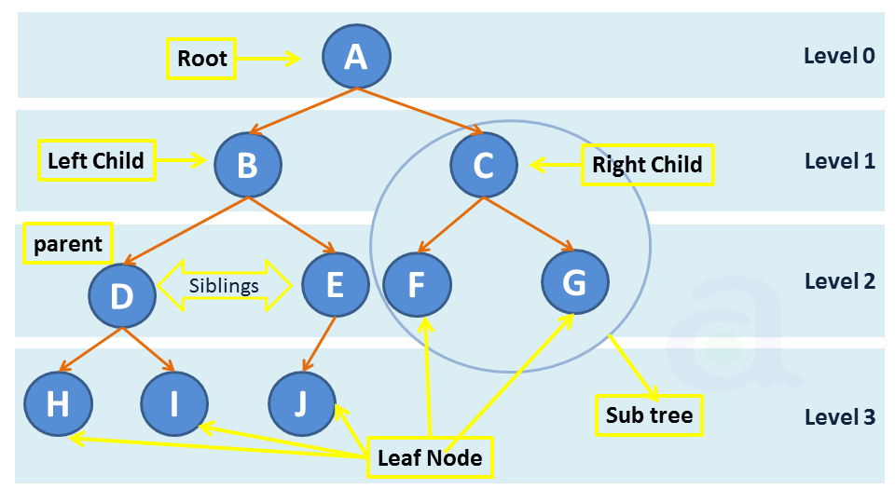

Introduction to Trees
The level of a vertex $v$ in a rooted tree is the length of the unique path from the root to this vertex.
The level of the root is defined to be zero.
The height of a rooted tree is the maximum of the levels of vertices.

Slide 18
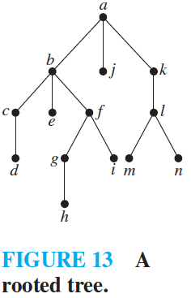
Introduction to Trees
Find the level of each vertex in the rooted tree shown in Figure 13. What is the height of this tree?

Slide 19
Introduction to Trees
Find the level of each vertex in the rooted tree shown in Figure 13. What is the height of this tree?
The root a is at level 0.
Vertices b, j, and k are at level 1.
Vertices c, e, f , and l are at level 2.
Vertices d, g, i, m, and n are at level 3.
Vertex h is at level 4. Because the largest level of any vertex is 4.
This tree has height 4.

Slide 20
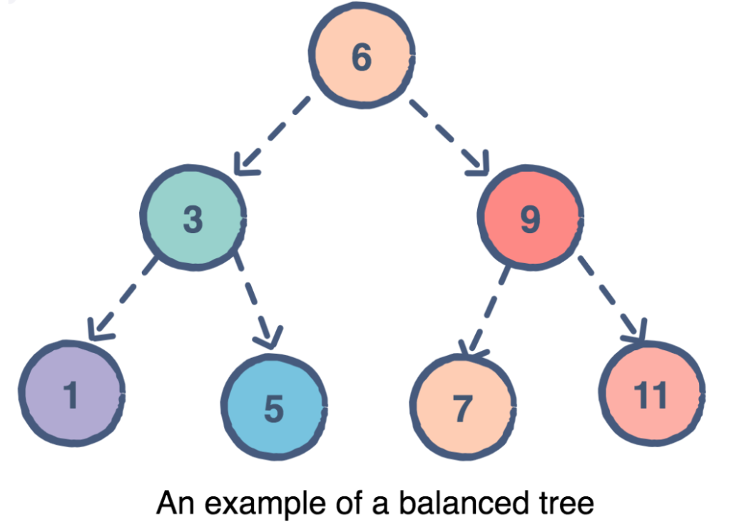

Introduction to Trees
A rooted $m−ary$ tree of height $h$ is balanced if all leaves are at levels $h$ or $h − 1$.

Slide 21
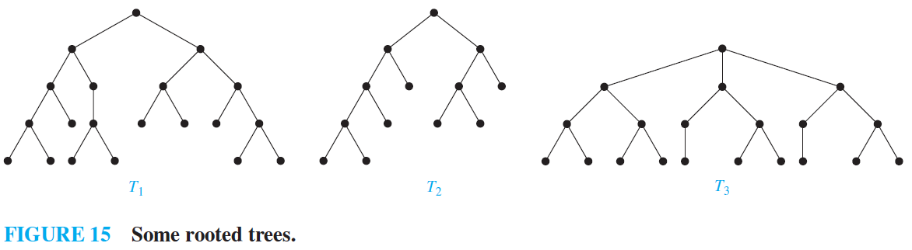
Introduction to Trees
Which of the rooted trees shown in Figure 14 are balanced?

Slide 22
Introduction to Trees
Which of the rooted trees shown in Figure 14 are balanced?
T1 is balanced, because all its leaves are at levels 3 and 4.
T2 is not balanced, because it has leaves at levels 2, 3, and 4.
T3 is balanced, because all its leaves are atlevel 3.

Slide 23

Introduction to Trees
There are at most $m^{h}$ leaves in an $m−ary$ tree of height $h$.

Slide 24
Content
CH 11
Introduction to Trees
Spanning Trees

Slide 25
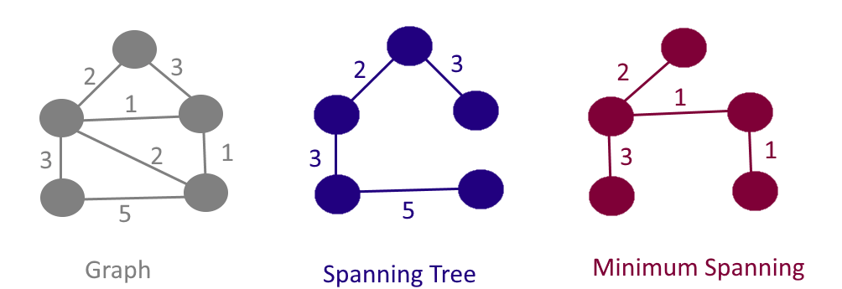
Spanning Trees
Let G be a simple graph. A spanning tree of G is a subgraph of G that is a tree containing every vertex of G.

Slide 26
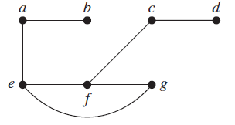
Spanning Trees
Find a spanning tree of the simple graph G shown in Figure 2.

Slide 27
Spanning Trees
Find a spanning tree of the simple graph G shown in Figure 2.
The graph G is connected, but it is not a tree because it contains simple circuits.

Slide 28
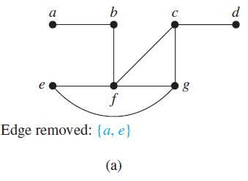
Spanning Trees
Find a spanning tree of the simple graph G shown in Figure 2.
Remove the edge {a, e}. This eliminates one simple circuit, and the resulting subgraph is still connected and still contains every vertex of G.

Slide 29
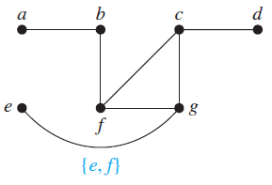
Spanning Trees
Find a spanning tree of the simple graph G shown in Figure 2.
Next remove the edge {e, f } to eliminate a second simple circuit.

Slide 30
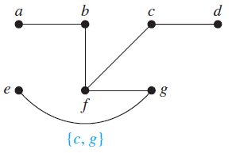
Spanning Trees
Find a spanning tree of the simple graph G shown in Figure 2.
Finally, remove edge {c, g} to produce a simple graph with no simple circuits. This subgraph is a spanning tree, because it is a tree that contains every vertex of G.

Slide 31
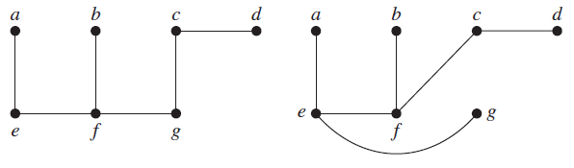
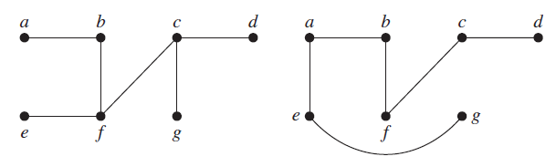
Spanning Trees
Find a spanning tree of the simple graph G shown in Figure 2.

Slide 32
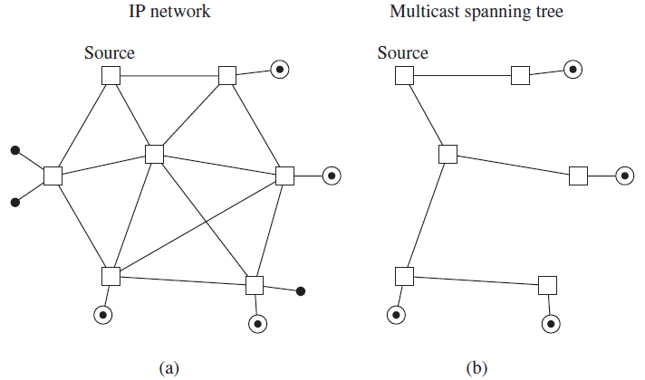
Spanning Trees
IP multicasting

Slide 33
Spanning Trees
Instead of constructing spanning trees by removing edges, spanning trees can be built up by successively adding edges.
Algorithms
depth-first search
breadth-first search

Slide 34
Spanning Trees
Depth-first search - form a rooted tree, and the spanning tree will be the underlying undirected graph of this rooted tree.

Slide 35
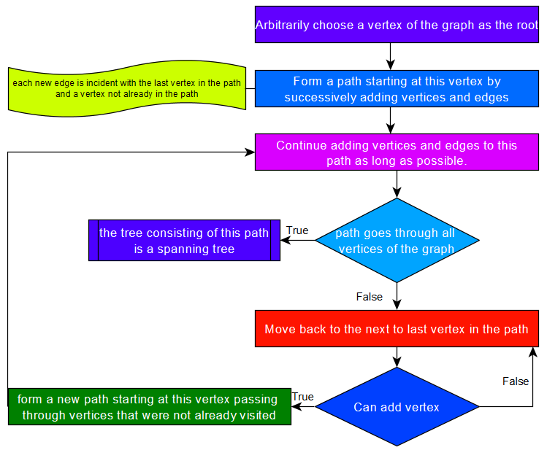

Slide 36
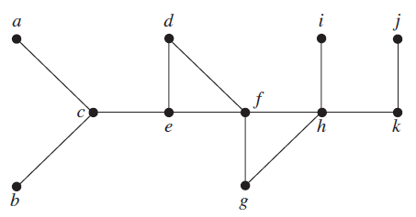
Spanning Trees
Use depth-first search to find a spanning tree for the graph G.

Slide 37
Spanning Trees
Use depth-first search to find a spanning tree for the graph G.

Slide 38

Spanning Trees
Use depth-first search to find a spanning tree for the graph G.

Slide 39
Spanning Trees
Use depth-first search to find a spanning tree for the graph G.

Slide 40
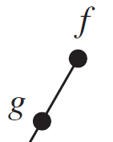
Spanning Trees
Use depth-first search to find a spanning tree for the graph G.

Slide 41
Spanning Trees
Use depth-first search to find a spanning tree for the graph G.

Slide 42
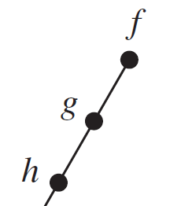
Spanning Trees
Use depth-first search to find a spanning tree for the graph G.

Slide 43
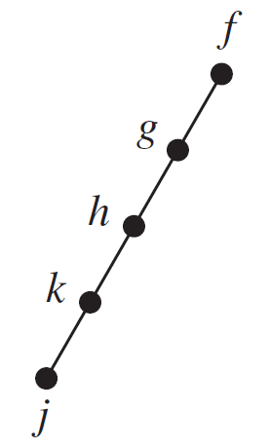
Spanning Trees
Use depth-first search to find a spanning tree for the graph G.

Slide 44
Spanning Trees
Use depth-first search to find a spanning tree for the graph G.

Slide 45
Spanning Trees
Use depth-first search to find a spanning tree for the graph G.

Slide 46
Spanning Trees
Use depth-first search to find a spanning tree for the graph G.

Slide 47
Spanning Trees
Use depth-first search to find a spanning tree for the graph G.

Slide 48
Spanning Trees
Use depth-first search to find a spanning tree for the graph G.

Slide 49
Spanning Trees
Use depth-first search to find a spanning tree for the graph G.

Slide 50
Spanning Trees
Use depth-first search to find a spanning tree for the graph G.

Slide 51
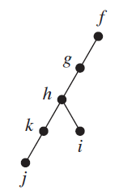
Spanning Trees
Use depth-first search to find a spanning tree for the graph G.

Slide 52
Spanning Trees
Use depth-first search to find a spanning tree for the graph G.

Slide 53
Spanning Trees
Use depth-first search to find a spanning tree for the graph G.

Slide 54
Spanning Trees
Use depth-first search to find a spanning tree for the graph G.

Slide 55
Spanning Trees
Use depth-first search to find a spanning tree for the graph G.

Slide 56
Spanning Trees
Use depth-first search to find a spanning tree for the graph G.

Slide 57
Spanning Trees
Use depth-first search to find a spanning tree for the graph G.

Slide 58
Spanning Trees
Use depth-first search to find a spanning tree for the graph G.

Slide 59
Spanning Trees
Use depth-first search to find a spanning tree for the graph G.

Slide 60
Spanning Trees
Use depth-first search to find a spanning tree for the graph G.

Slide 61
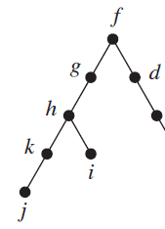
Spanning Trees
Use depth-first search to find a spanning tree for the graph G.

Slide 62
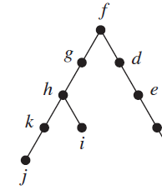
Spanning Trees
Use depth-first search to find a spanning tree for the graph G.

Slide 63
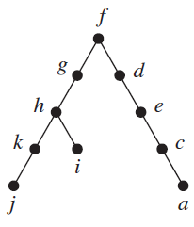
Spanning Trees
Use depth-first search to find a spanning tree for the graph G.

Slide 64
Spanning Trees
Use depth-first search to find a spanning tree for the graph G.

Slide 65
Spanning Trees
Use depth-first search to find a spanning tree for the graph G.

Slide 66
Spanning Trees
Use depth-first search to find a spanning tree for the graph G.

Slide 67
Spanning Trees
Use depth-first search to find a spanning tree for the graph G.

Slide 68
Spanning Trees
Use depth-first search to find a spanning tree for the graph G.

Slide 69
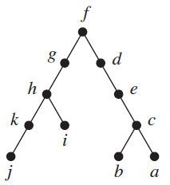
Spanning Trees
Use depth-first search to find a spanning tree for the graph G.

Slide 70
Spanning Trees
Use depth-first search to find a spanning tree for the graph G.

Slide 71
Spanning Trees
Use depth-first search to find a spanning tree for the graph G.

Slide 72
Spanning Trees
Use depth-first search to find a spanning tree for the graph G.

